Slide 1
Southern Corporation Case Study –Capstone Project Ahmad Saquib Sina

Slide 2
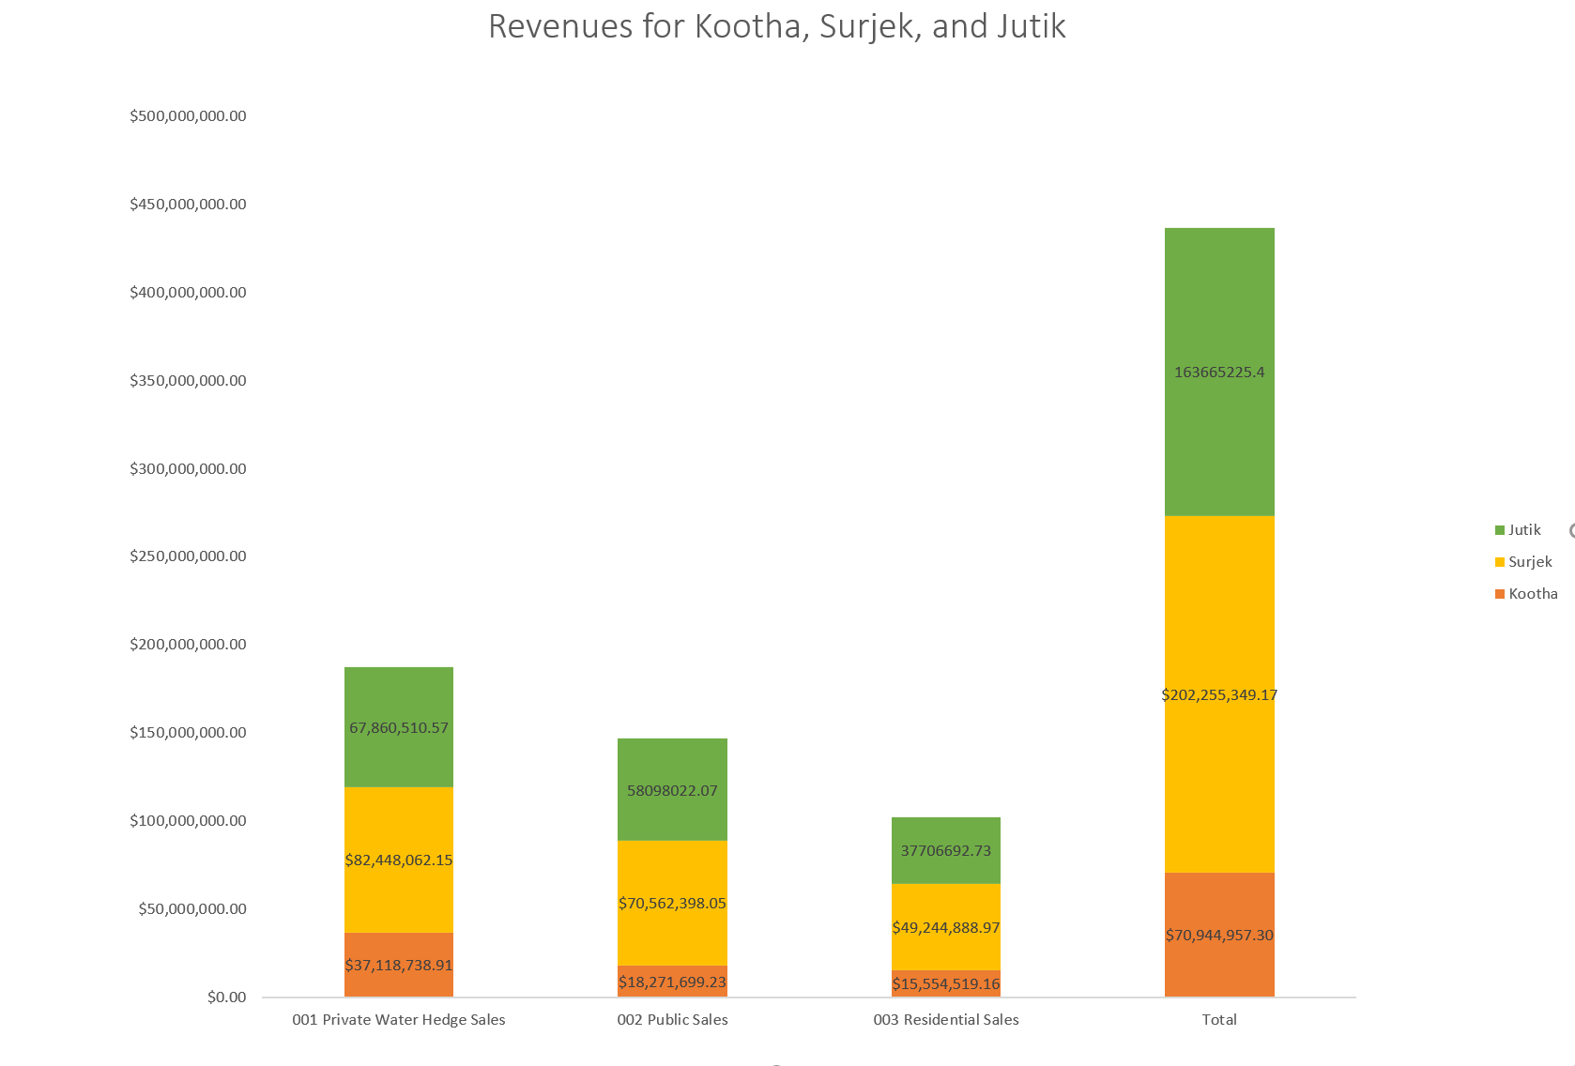
The graph clearly shows that Surjek unit has the highest revenue. The second highest revenue is for Jutik unit, and Kootha has the lowest revenue

Slide 3
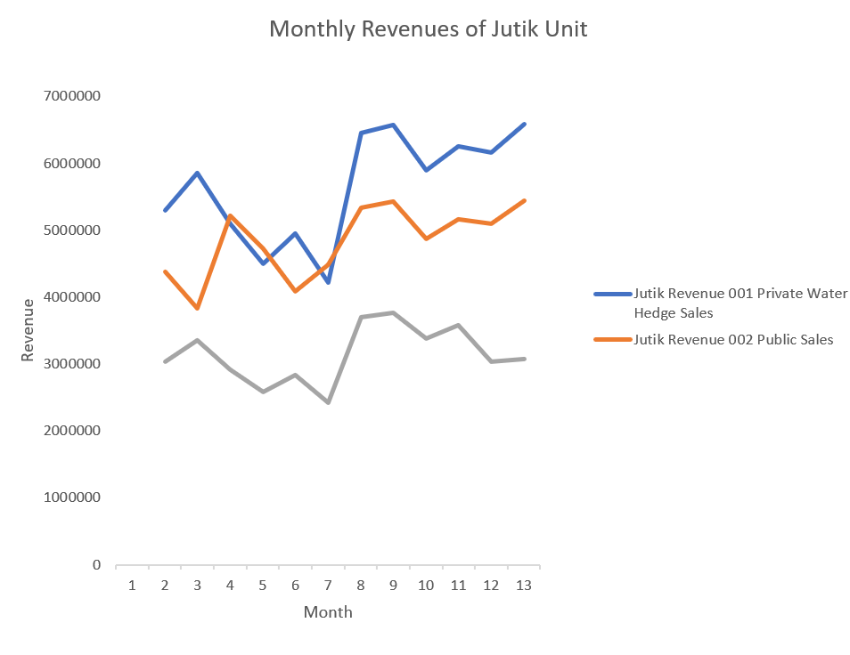
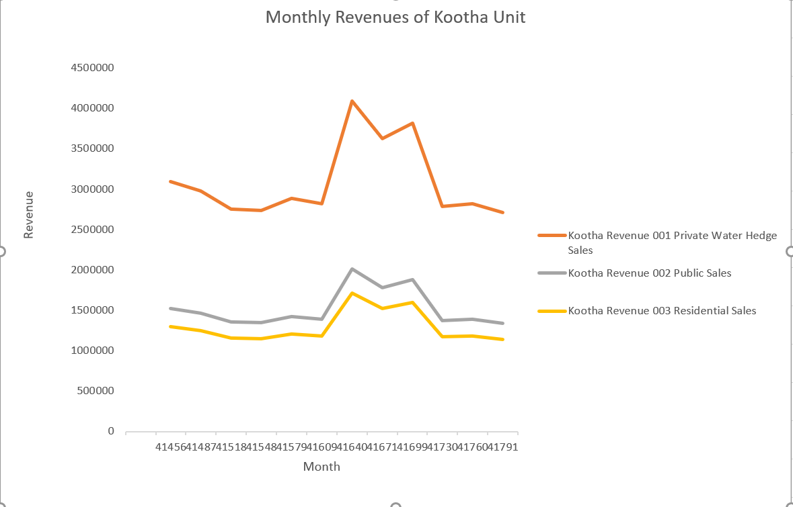
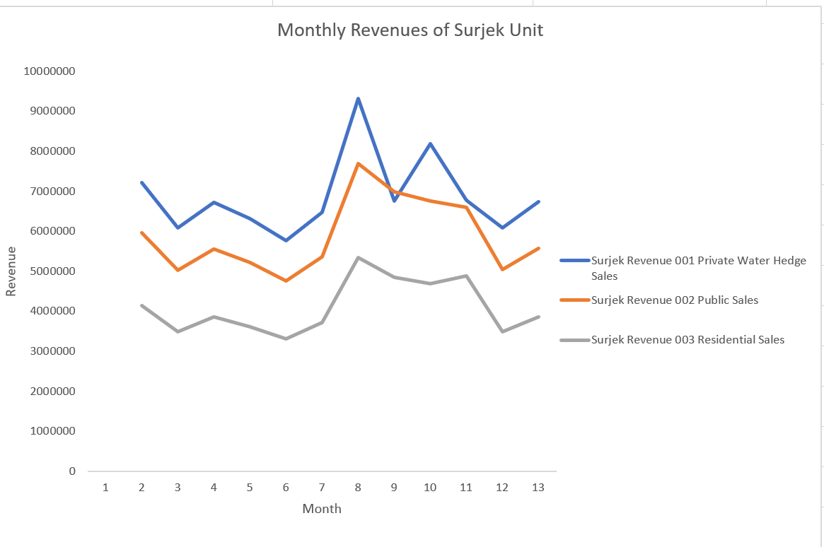
These three charts show that the revenue for Private Water Hedge Sales is higher than Public sales and Residential sales for all units. The second highest revenue is for Public Sales and the lower revenue is for Residential unit

Slide 4
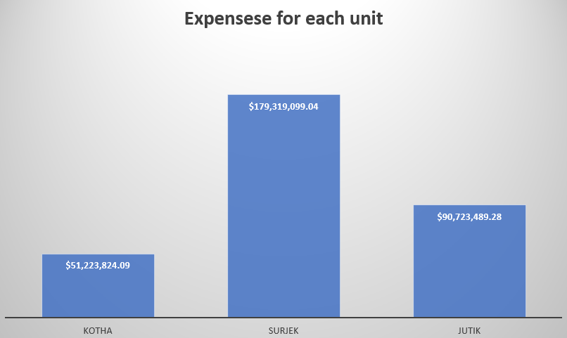
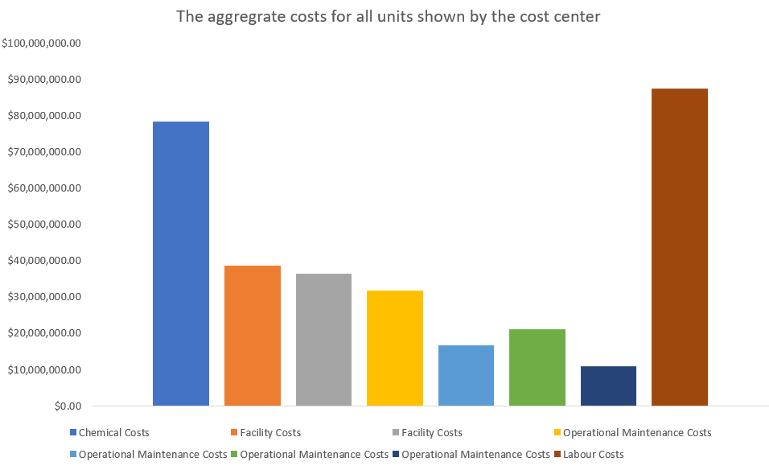
The first chart shows that Surjek unit has the highest expenses and Jutik has second highest expenses. Finally, Kootha has the least expenses. The secondary chart demonstrates that labour costs have the highest expenses. The second highest expenses is for chemical costs.

Slide 5
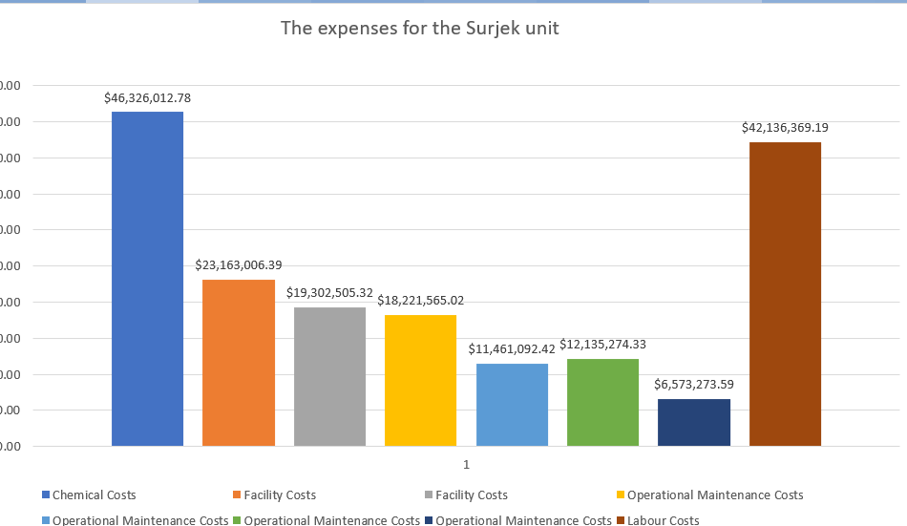
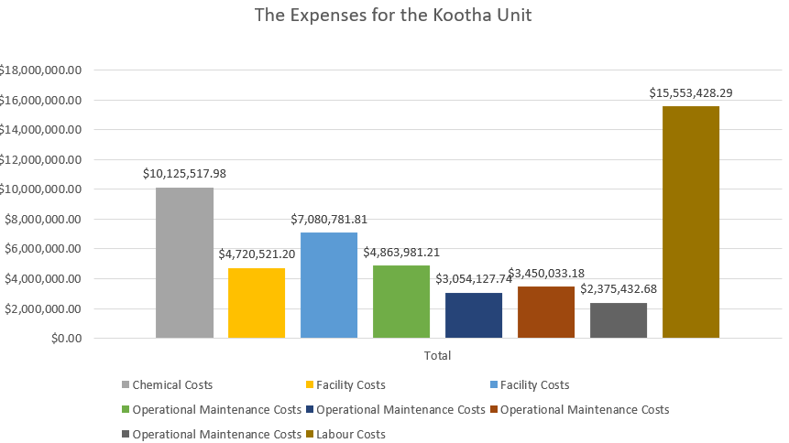
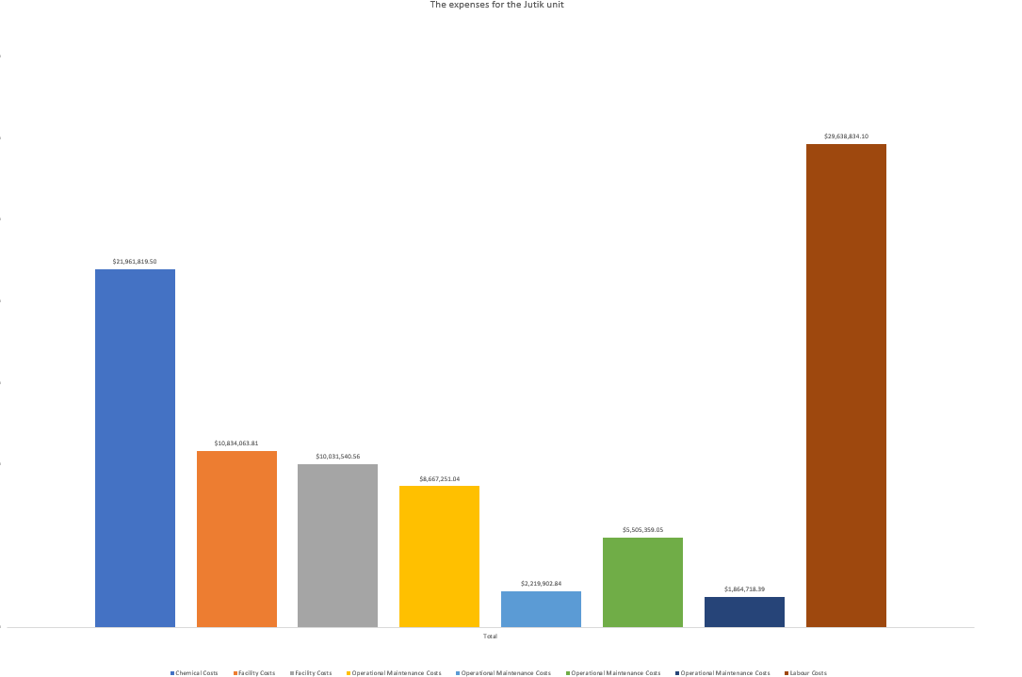
These three charts demonstrate that chemical costs are higher than labour costs for the Surjek unit. However, labour costs are the highest in both Kootha and Jutik units.

Slide 6
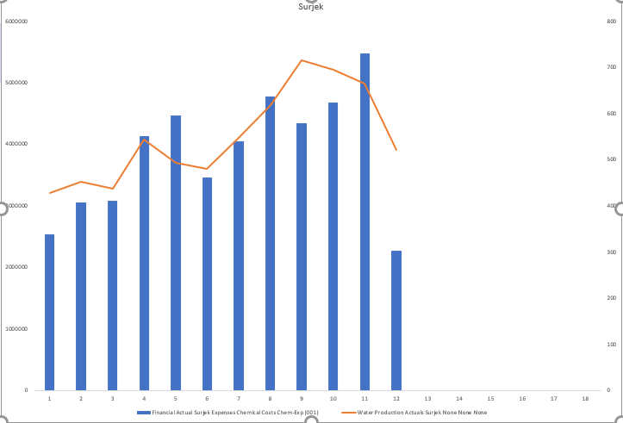
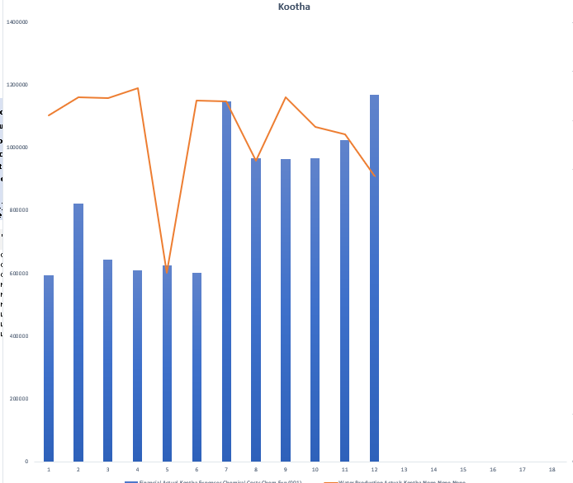
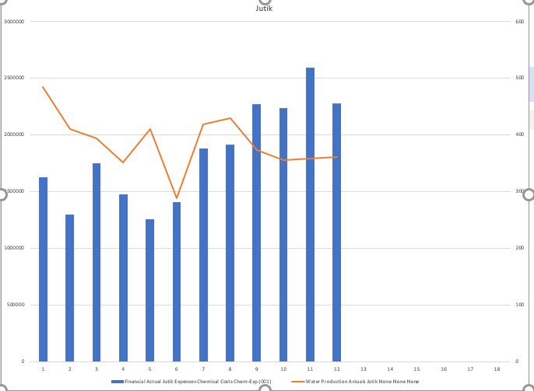
Based on the combo chart, there appears to by a relationship between the chemical expenditure and water production. This is more visible for the Surjek unit. For the Surjek unit, it is apparent that water production increases with the usage of chemicals and vice versa.

Slide 7
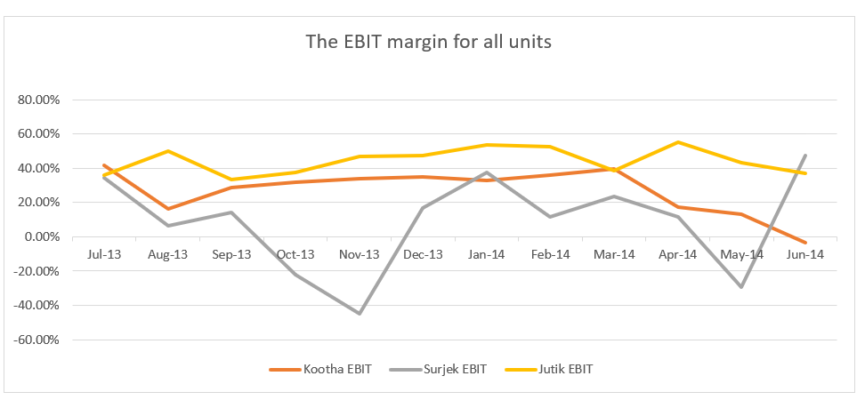
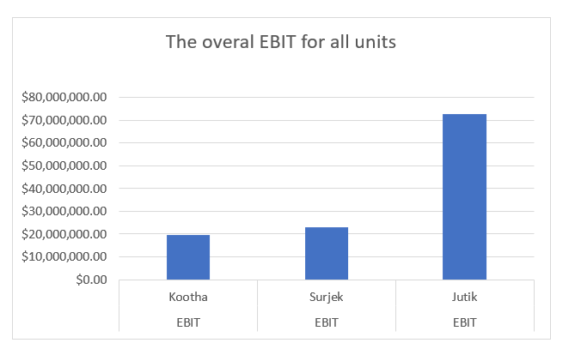
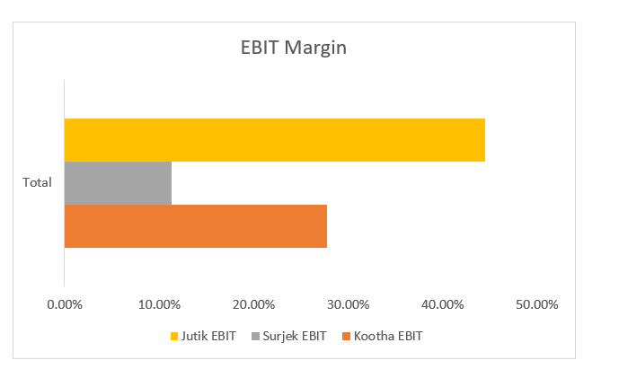
Concluding our analysis, Jutik has the highest overall EBIT contributions , followed by Surjek , and lastly Kootha. However, from an EBIT Margin (%) perspective, Kootha has a higher margin than that of Surjek, indicative of a lower revenue-to-expense ratio.¹

Slide 8
Descriptive and inferential statistical methodologies have proven effective in creating a proactive ‘alarm’, accurately identifying Pump Failures with Horse Power (HP) and Pump Efficiency (PE) emerging as key variables of interest with deviations of 15 HP and > 3 % PE being our core signal thresholds.
PUMP FAILURE (1 or 0)
Raw Data | Correlation Coefficient
Volumetric Flow Meter 2 | -0.11211472
Pump Efficiency | -0.102684351
Volumetric Flow Meter 1 | -0.102508317
Ambient Temperature | 0.20794584
Pump Torque | 0.233192706
Pump Speed (RPM) | 0.260016062
Horse-Power | 0.421844074
PUMP FAILURE (1 or 0) | Rolling Mean (30 Minute) Correlation Coefficient
Volumetric Flow Meter 2 | -0.697731416
Pump Efficiency | -0.695027831
Volumetric Flow Meter 1 | -0.692425138
Ambient Temperature | -0.302615535
Pump Torque | -0.215937441
Pump Speed (RPM) | -0.184159622
Horse-Power | 0.218050641
PUMP FAILURE (1 or 0)
Rolling Stdev (30 Minute) | Correlation Coefficient
Pump Torque | 0.597260414
Ambient Temperature | 0.600050431
Pump Speed (RPM) | 0.624555908
Volumetric Flow Meter 2 | 0.625920871
Pump Efficiency | 0.64
Volumetric Flow Meter 1 | 0.64
Horse Power | 0.69

Slide 9
Descriptive Analysis has enabled us to clearly identify particular signature abnormalities showing clear signature changes in both Rolling Standard Deviation and Rolling Mean Datasets when observed over the respective failure period of interest.

Slide 10
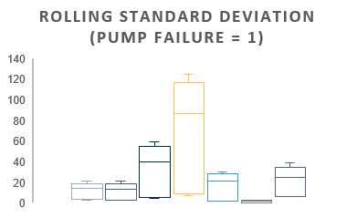
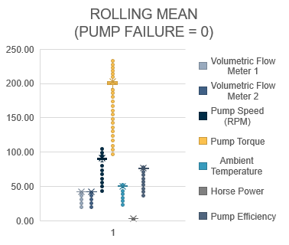
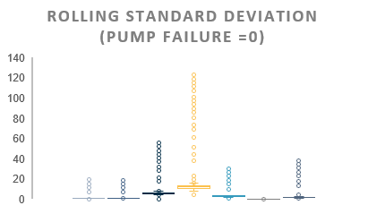
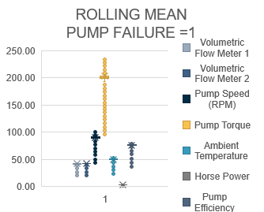
Plots show a clear signature difference between that of normal behaviour and that of Failure with pump torque, pump speed, and pump efficiency showing the 3 largest variances.

Slide 11
Lastly, analysis of the statistical significance of variables contributing towards Pump Failure reveal that with a R Squared of 0.778, a linear model is a good fit for the data with both Rolling Mean and Rolling Standard Deviation datasets contributing key information to understand Pump Failure mechanics.
Variable | P-Value Significance
Horse Power | 3.5524E-219
Volumetric Flow Meter 2 | 2.033E-174
Pump Efficiency | 2.592E-152
Pump Torque | 1.0551E-102
Intercept | 8.27258E-24
Pump Speed (RPM) | 1.68299E-19
Ambient Temperature | 4.20516E-09
Volumetric Flow Meter 1 | 4.01554E-07

Slide 12
With a estimated 29.95% reduction in Surjek’s Revenues ($141 M) due to the Maintenance Outage, Quarter Q4 presents the best balance of revenue-loss mitigation with respect to market pricing, as opposed to Quarter Q1 which represents the highest demand (2273 GL) and Water Balancing Market Prices (84.84).

Slide 13
Of the three Desalination Plants, all three remain profitable at current market prices by a favourable margin; Clearly Kootha is the most cost-effective $25/ML) followed by Jutik ($35.80/ML) and lastly Surjek ($54/ML) which is consistent across the July-2013 to June-2014 period.

Slide 14
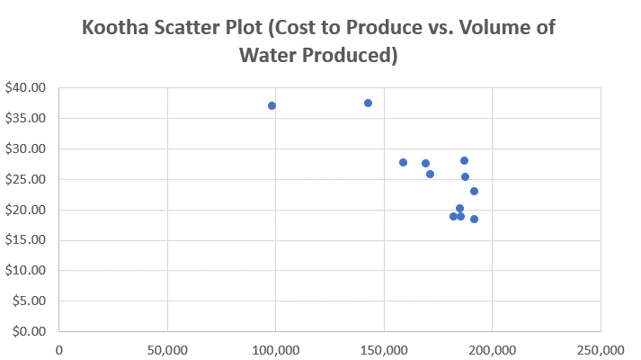
Contrasting the Cost to Produce against the Volume of Water Produced highlights clear economies of scale with costs rapidly dwindling across all plants as volume surges, with this being particularly noticeable across the Kootha and Surjek Plants with costs dropping as much as 50%.

Slide 15
Drilling down further from a product-perspective, reveals two different patterns of elasticity where hard water tends to be relatively price elastic regardless of quantity purchased, whilst soft water is more representative of an inelastic price-to-volume relationship.

Slide 16
Lastly, when viewing the economic pricing data from an micro-perspective, it is indicative that Hard Water is seen as more of a ‘less core’ product than that of Soft Water whose price remains largely flexible

Slide 17
Correlation analyses across datasets yield particularly interesting insights with pump efficiency and Volumetric Flow Meter 1 negatively correlated with Pump Failure in the Rolling Mean Data, whilst pump efficiency and Volumetric Flow Meter 1 show a subsequently strong positive correlation in the Rolling STDEV Dataset.

